Slide 1

Nastro Bliss: Transforming Your Restaurant with AWS
A strategic partnership bringing clarity, efficiency, and growth to your digital operations.

Slide 2
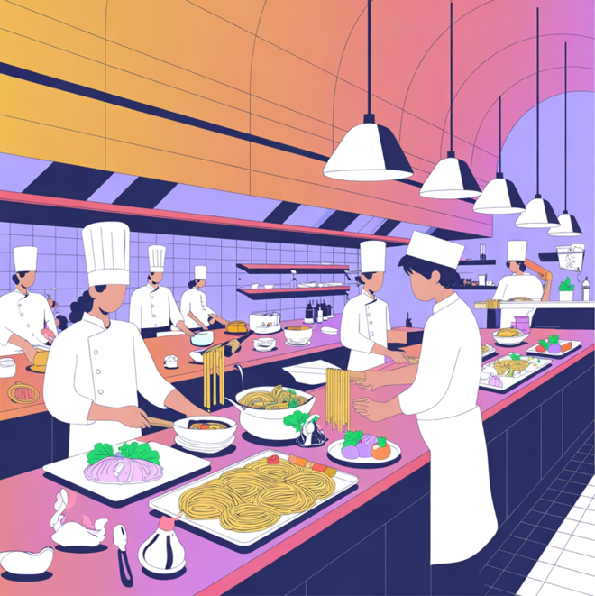
Restaurant Overview
About Nastro Bliss
Nastro Bliss is a beloved restaurant situated at Johannesburg known for contemporary African cuisine and specializing in grill and fire menu items. Catering to local residence, corporate partners and to tourists to showcase their take and expertise in on African cuisine. The restaurant is ready to scale operations and enhance how customers connect with the business.

Slide 3

Current Operational
Challenges
Booking Confusion
Order Mix-ups
Reservation requests come through multiple channels—phone, walk-ins, social media. Information gets lost, double-booked tables create frustration.
Orders placed verbally or via text lead to incorrect items, forgotten requests, and unhappy customers during peak hours.
No Digital Presence
Without an organized online platform, customers can't easily find menu information, hours, or availability—hurting discoverability.

Slide 4



The Business Impact
30%
40%
25%
Lost Revenue
Staff Time Wasted
Customer Satisfaction
Customers turn to competitors with better online booking systems
Hours spent managing manual bookings and resolving order errors
Negative reviews from booking
mix-ups and incorrect orders
Notes:
Lost Revenue
Customers turn to competitors with better online booking systems.

Slide 5
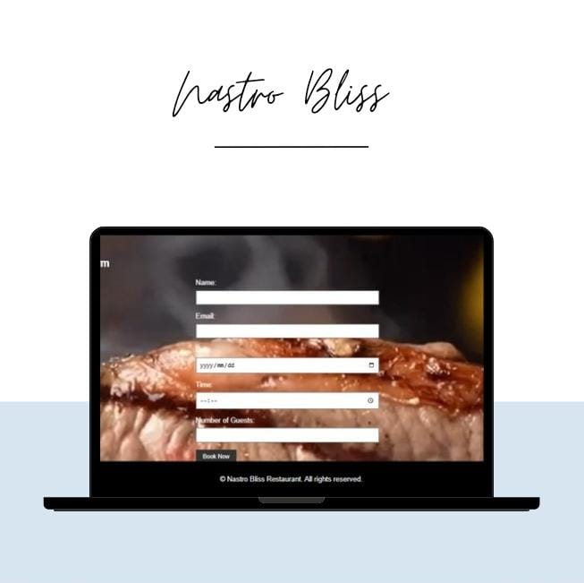

The Solution: A Static Website on AWS
Centralized Booking System
Customers reserve tables directly online with instant confirmation. No more phone tag or confusion.
Digital Menu & Ordering
Showcase your full menu, specials, and pricing. Customers can place orders ahead with clear details.
Real-Time Information
Hours, location, availability updates push instantly to customers through a always-on website.

Slide 6

Why AWS? Built for Small Business Growth
Reliability You Can Trust
AWS ensures your website is always available—99.99% uptime means customers can book call or email 24/7, even during your busiest dinner service.

Slide 7
Key Benefits of Migration to AWS
Eliminate Manual Booking Errors
Reduce Operational Costs
Automated reservation system reduces confusion and creates a professional customer experience that builds loyalty.
Staff spends less time managing reservations and orders, freeing them to focus on exceptional customer service and kitchen efficiency.
Increase Revenue Opportunities
Improve Customer Satisfaction
Online presence attracts new customers, enables pre-orders and advanced bookings, and creates upsell opportunities through digital promotions.
Seamless booking and ordering experience leads to positive reviews, repeat customers, and powerful word-of-mouth marketing.

Slide 8
AWS Services/Architecture
Amazon S3 – Hosts static website content
Amazon Route 53 – Domain management
Amazon CloudFront – Speeds up delivery through CDN
IAM – Controls access and security

Slide 9
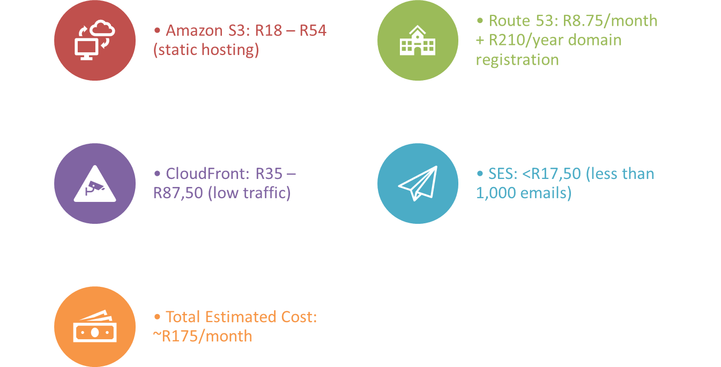
AWS Cost Analysis

Slide 10

Security & Peace of Mind
Data Protection
Compliance Ready
AWS uses a high level of security to protect its customers data. Your reputation and the customer’s trust are safe.
AWS infrastructure meets industry best practices for data handling, giving you complete confidentiality and compliance.
Automatic Backups
Your website and customer data are automatically backed up. No worry about losing important reservation or order information.

Slide 11
Your Path Forward
Phase 1: Design & Planning
1
We assess your needs and design a website tailored to Nastro Bliss operations.
2
Phase 2: Build & Deploy
Website launches on AWS with booking and ordering capabilities fully operational.
Phase 3: Train & Optimize
3
Your team learns to manage the system. We monitor and optimize for peak performance.
4
Phase 4: Grow & Evolve
As business grows, add features like online payments, loyalty programs, and mobile app integration.

Slide 12


Transform Today
Nastro Bliss is ready to streamline operations, delight customers, and unlock new revenue. AWS provides the reliable, affordable foundation to make it happen.
Next Step: Schedule a consultation to discuss your specific needs and get a custom implementation timeline and quote.

